Slide 1
CS2422 Assembly Language & System Programming
December 4, 2003

Slide 2
Today’s Topic
Assembler Design Options
  One-pass assemblers
  Multi-pass assemblers
  Two-pass assembler with overlay structure

Slide 3
Study Guide
Section 2.4 of Beck’s “System Software” book.

Slide 4
Two-Pass Assembler with Overlay Structure (1/3)
For small memory
  Pass 1 and pass 2 are never required at the same time
  Three segments
    Root: driver program and shared tables and subroutines
    Pass 1
    Pass 2
  Tree structure
  Overlay program

Slide 5
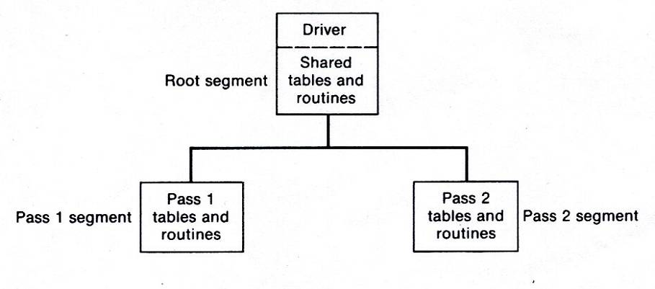
Two-Pass Assembler with Overlay Structure (2/3)
Tree structure

Slide 6
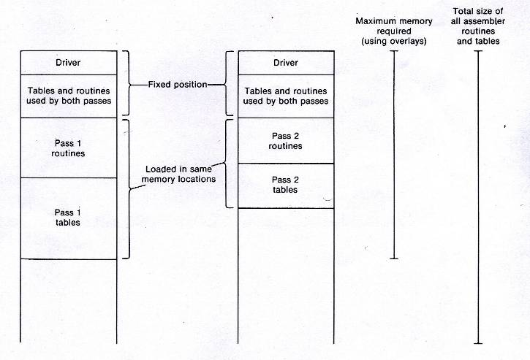
Two-Pass Assembler with Overlay Structure (3/3)
Overlay programs

Slide 7
One-Pass Assemblers (1/2)
Main problem
  Forward references
    Data items
    Labels on instructions
Solution
  Data items: require all such areas be defined before they are referenced
  Labels on instructions: no good solution

Slide 8
One-Pass Assemblers (2/2)
Two types of one-pass assembler
  Load-and-go
    Produces object code directly in memory for immediate execution
  The other
    Produces usual kind of object code for later execution

Slide 9
Load-and-go Assembler (1/3)
Characteristics
  Useful for program development and testing
  Avoids the overhead of writing the object program out and reading it back
  Both one-pass and two-pass assemblers can be designed as load-and-go.
  However one-pass also avoids the over head of an additional pass over the source program
  For a load-and-go assembler, the actual address must be known at assembly time, we can use an absolute program

Slide 10
Load-and-go Assembler (2/3)
For ward references handling
  1. Omit the address translation
  2. Insert the symbol into SYMTAB, and mark this symbol undefined
  3. The address that refers to the undefined symbol is added to a list of forward references associated with the symbol table entry
  4. When the definition for a symbol is encountered, the proper address for the symbol is then inserted into any instructions previous generated according to the forward reference list

Slide 11
Load-and-go Assembler (3/3)
At the end of the program
  Any SYMTAB entries that are still marked with * indicate undefined symbols
  Search SYMTAB for the symbol named in the END statement and jump to this location to begin execution
The actual starting address must be specified at assembly time
Example
  Figure 2.18, 2.19

Slide 12
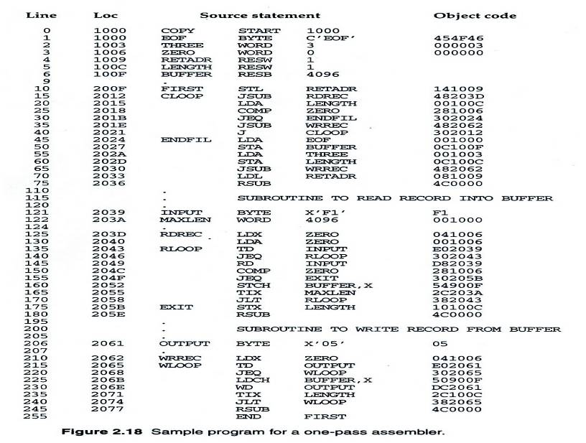
Figure 2.18

Slide 13
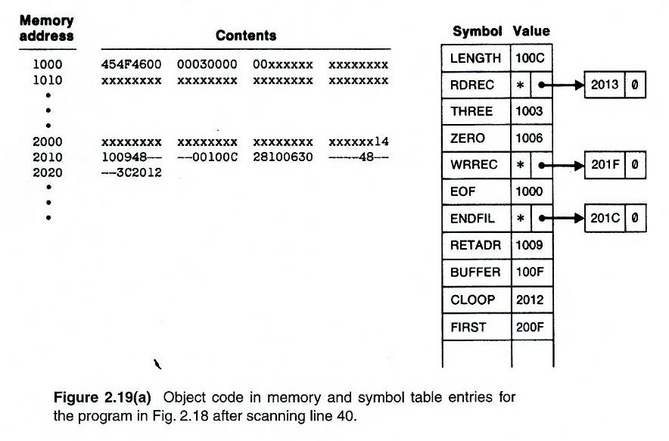
Figure 2.19(a)

Slide 14
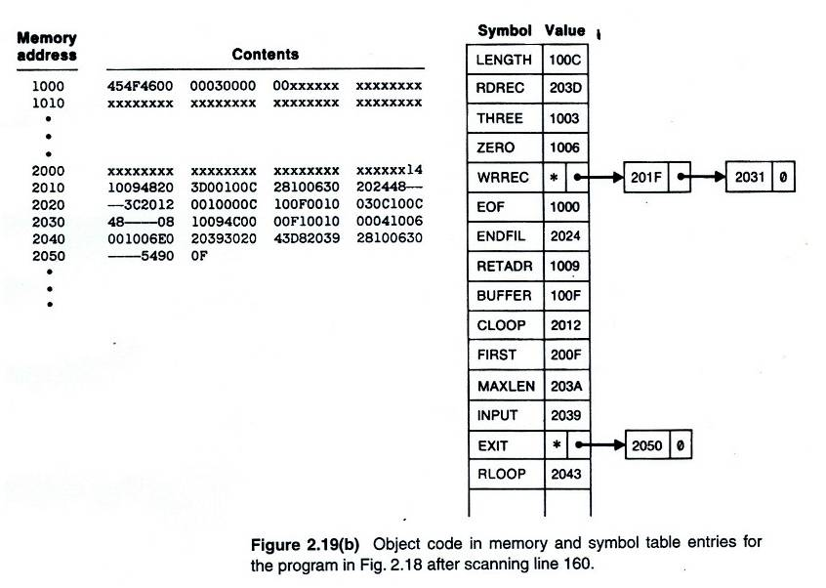
Figure 2.19(b)

Slide 15
Producing Object Code
When external working-storage devices are not available or too slow (for the intermediate file between the two passes
Solution:
  When definition of a symbol is encountered, the assembler must generate another Tex record with the correct operand address
  The loader is used to complete forward references that could not be handled by the assembler
  The object program records must be kept in their original order when they are presented to the loader
Example: Figure 2.20

Slide 16
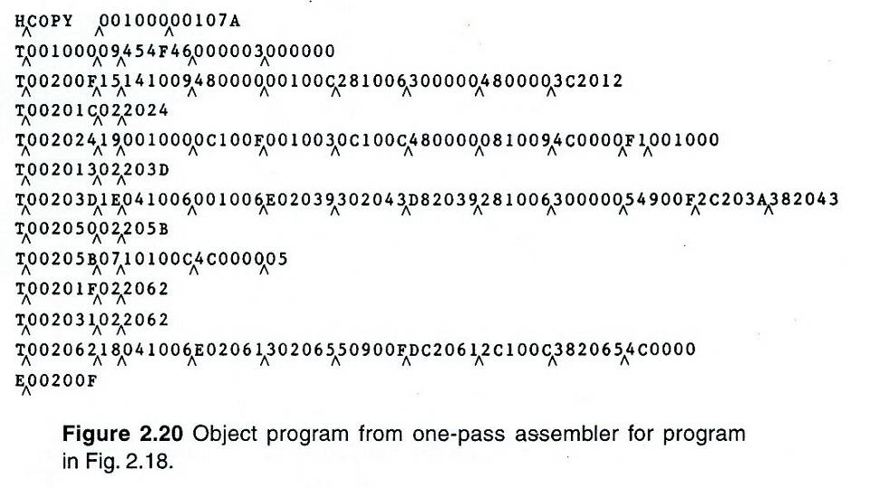
Figure 2.20

Slide 17
Multi-Pass Assemblers
Restriction on EQU and ORG
  No forward reference, since symbols’ value can’t be defined during the first pass
Example
  Use link list to keep track of whose value depend on an undefined symbol
Figure 2.21

Slide 18
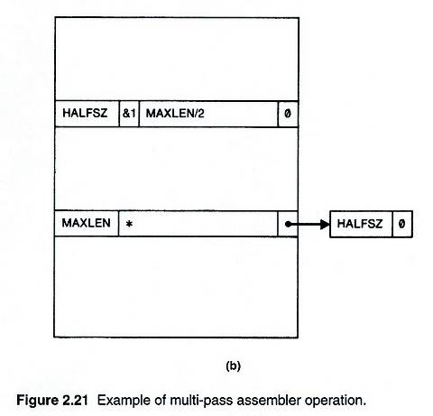
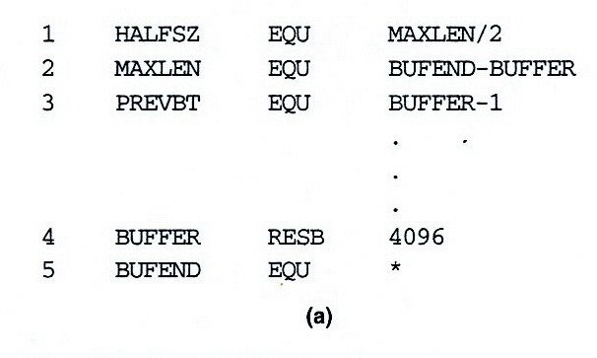
Figure 2.21 (1/5)

Slide 19
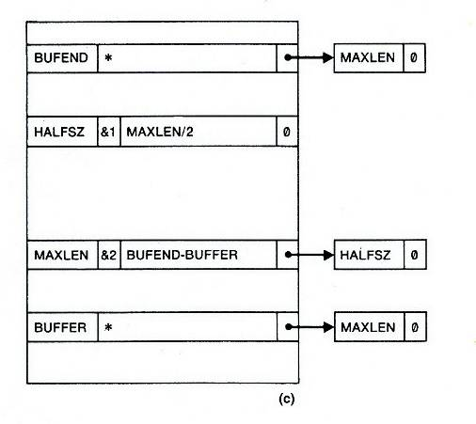
Figure 2.21 (2/5)

Slide 20
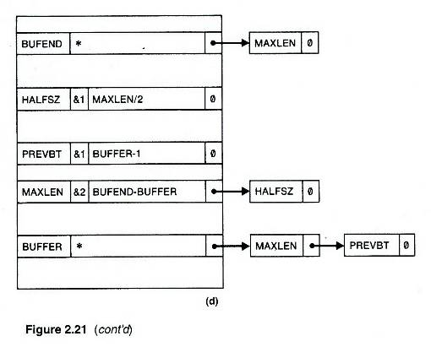
Figure 2.21 (3/5)

Slide 21
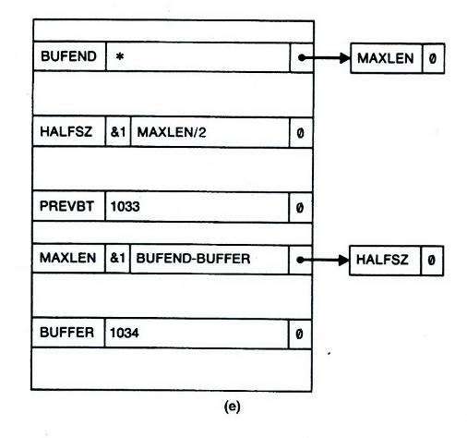
Figure 2.21 (4/5)

Slide 22
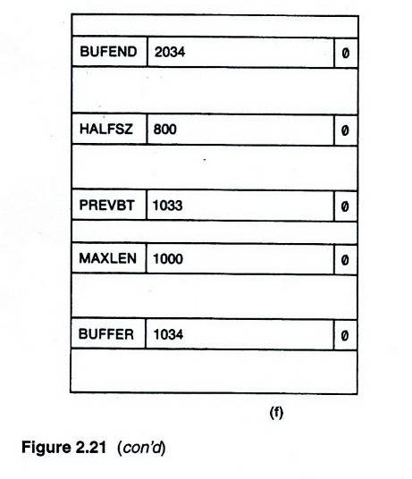
Figure 2.21 (5/5)

